Slide 1
DCPS Student’s Guide to Graduation, College, and Career Student and Family Overview
Notes:
Welcome
During this presentation we’ll review your personalized Guide to Graduation, College, and Career.

Slide 2
Objectives and Agenda
We will:
Learn about how the Guide to Graduation, Career, and College fits in to your planning for graduation and beyond
Review the content of the Guide and how to understand and act on the data
Discuss ways that we can make sure that students are being supported to use the guide to help plan for the future
Context
Content
Next Steps
Postsecondary Planning
Graduation Planning
Walkthrough of guide
Discussion
Notes:
During this this presentation we’ll review the “why” of the guide and how it fits in to your planning and goals for graduation and beyond. We’ll also walk through the guide itself- page by page- and we’ll end with a discussion on what’s next and how you can use this information.

Slide 3
Guide to Graduation, College, and Career: Why did you get it?
Our Goal:
Provide students, families, staff, and partners with a clear understanding of college and career pathways based on a student’s individualized metrics/plans
Guide to Graduation, College, and Career
Graduation Planning
Postsecondary Planning
Notes:
Our vision at DCPS and (school name) is for every student to feel loved, challenged and prepared to positively influence society and thrive in life. Graduating individuals who embody our vision and who are fully prepared to take on “what’s next” is work that can’t be done in isolation. We need the partnership of the community, families and partners to realize our vision for the future. Our aim is that this resource provides a baseline of transparency that supports a conversation between schools, students and families about where kids are and what we all need to do to support that kid to succeed.

Slide 4
Guide to Graduation, College, and Career: What is it?
Individualized
Action Oriented
Timely
Accessible
Notes:
So what is the DCPS Student’s Guide to Graduation, Career, and College? It’s an individualized document that provides students and families step by step guidance on graduation, college, and career pathways.
The Guide is:
Individualized: No two student’s guides are the same- it’s unique to your progress and interests. Data is pulled from your transcript, assessment scores, and post-secondary survey information.
Action Oriented: We want this guide to be much more than a piece of paper. It should provide students and families step by step guidance on graduation, college, and career pathways.
Timely: 12th grade students receive the Guide in Fall to help prepare for key deadlines. (9th-11th graders receive the guide in February to help finish the year strong and keep planning towards their postsecondary pathway goal.
Accessible: Mailed home and posted to the Aspen Family and Student Portal it’s translated into all 5 critical languages at DCPS: Amharic, Chinese, French, Spanish, and Vietnamese

Slide 5
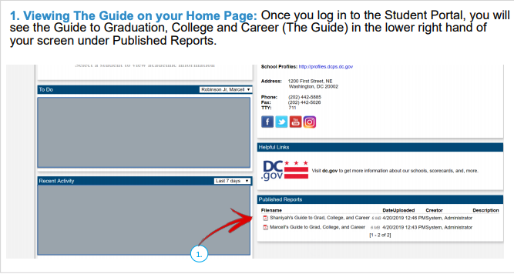
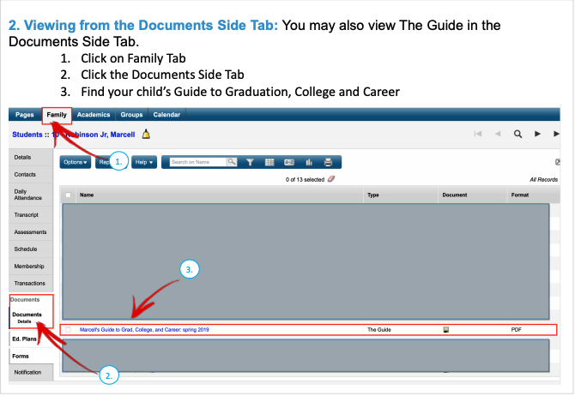
How Do I access my Guide to Graduation, College, and Career?
Every student has access to their Guide in Aspen.
In addition, every student will also receive a printed copy of their guide in the mail.
Notes:
Option: Video on how to access the Guide through Parent Portal: https://x6hvd3a3nak1ihbne2hhum47-wpengine.netdna-ssl.com/wp-content/uploads/How-to-Access-the-Guide-to-GCC.mp4
Every student has access to their Guide in Aspen:
Once logged into Aspen Student Portal, you will see the Guide to Graduation, College and Career in the lower right hand of your screen under Published Reports
Additionally, you may also access The Guide on the Documents Side Tabl by clicking on “Family Tab” then clicking the documents side tab and finding document “Student Name Guide tp Grad…”

Slide 6
CONTENT
Notes:
Now, let’s dig in to all the helpful information that’s inside!

Slide 7
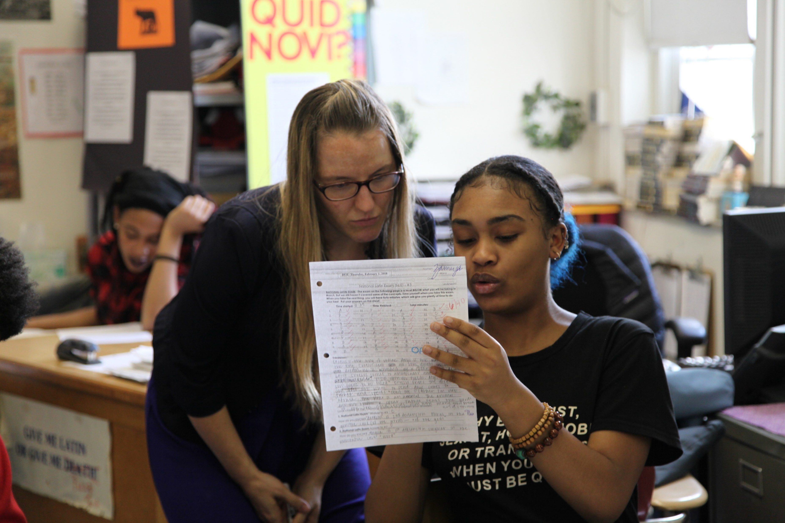
The first two pages
Page 1: Opening Letter
Page 2: Transcript- The record of your academic accomplishments in high school.
Remember! The transcript in your Guide isn’t official and can’t be sent to colleges or universities. Talk to your counselor to get a signed and sealed official transcript.
Notes:
The first thing you’ll see is a letter from Chancellor Ferebee.
This page also contains key contact information for your school, such as your principal’s name, your 12th grade counselor, and the college and career coordinator at your school (if applicable).
The next page contains your HS transcript.
A high school transcript is a record of your academic accomplishments in high school.
It lists every class you took, when you took them, and the grade you received in each class.
The transcript included in The Guide to Graduation, Career, and College is an unofficial transcript- this means it can’t be sent to colleges or universities.
To get an official transcript talk to your counselor or school registrar.

Slide 8
At the top of each page
PSAT/SAT= PSAT 8/9 is out of 1440, PSAT NMSQT is out of 1520 and the SAT is out of 1600.
Weighted GPA= Grade point avg that takes into account the difficulty of your courses
Community Service Hours= You need at least 100 hours of community service to graduate. Some schools require more
ISA= In Seat Attendance
Notes:
You’ll see the same blue bar across the top of each page moving forward. On the left is your name, grade and student ID. The grade level listed here is the same as on your transcript and is calculated based on the courses and credits that you’ve taken and passed.
Click
ISA= : In Seat Attendance (ISA) is the percentage of registered days a student is present at school. *This does include both excused and unexcused absences, but does not include days missed for school activities, in-school suspension, or when a student is receiving HHIP instruction. **12th grade Guide 2020 does not include ISA due to the shift to remote learning during the Spring of 2020 in response to Covid-19**
Click
PSAT & SAT= The SAT is an entrance exam used by most colleges and universities to make admissions decisions. It is a multiple-choice, pencil-and-paper test administered by the College Board. The SAT total score ranges from 400 to 1600 and is composed of Math and Evidenced Based Reading and Writing Sections (EBRW). The PSAT is a great primer for the SAT and is a qualifier for the National Merit Scholarship. There are two types of PSAT: PSAT 8/9 (score range of 240-1440)which 8th and 9th Graders take and PSAT NMSQT(score range of 320-1520) which 10th and 11th graders take.
Click
Community Service Hours= DCPS students need at least 100 hours to graduate. Some schools have higher requirements (highlight school specific requirement here) The number of hours here is the total that you reported to your school as of September 11th.
Click
Weighted GPA= Weighted GPA takes into account the difficulty of the courses a student takes (for example, AP, Honors, IB) and adjusts for that difficulty. Because of that, the scale can exceed a 4.0 whereas an unweighted GPA doesn't factor this in and only goes to 4.0

Slide 9
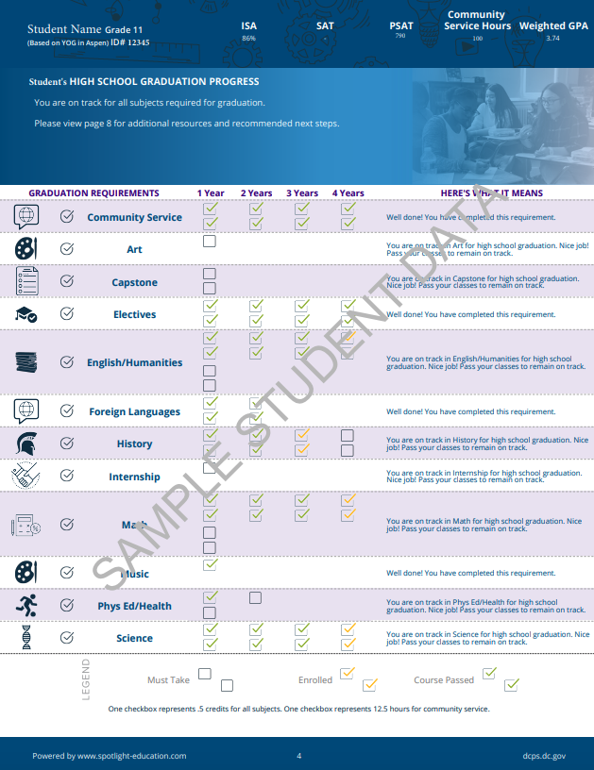
Page 3: Graduation
One checkbox = .5 credits for all subjects and 12.5 hours of community service.
Graduation requirements on this page are unique to the graduation requirements of each school.
If you are off track, talk to your counselor about getting back on track.
At the bottom is a key to what the checkboxes mean based on how they are filled in.
Notes:
Turning to the third page in your guide it should look like this- the one with the footprints- this is the graduation page.
Click
On this page you’ll find a personalized update on your progress toward graduation, based on the courses you’ve taken and passed and the number of community service hours that you’ve reported.
At the top: Overview of progress toward graduation and conversion of footprints to credits/hours
One footprint = .5 credits for all subjects and 12.5 hours of community service.
Graduation requirements on this page are unique to the graduation requirements of our school.
If you are off track, it will say that in the "Here's what it means" column. You should talk to your counselor about getting back on track.
At the bottom is a key to what the footprints mean based on how they are filled in.

Slide 10
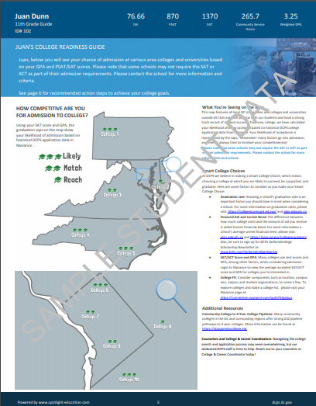
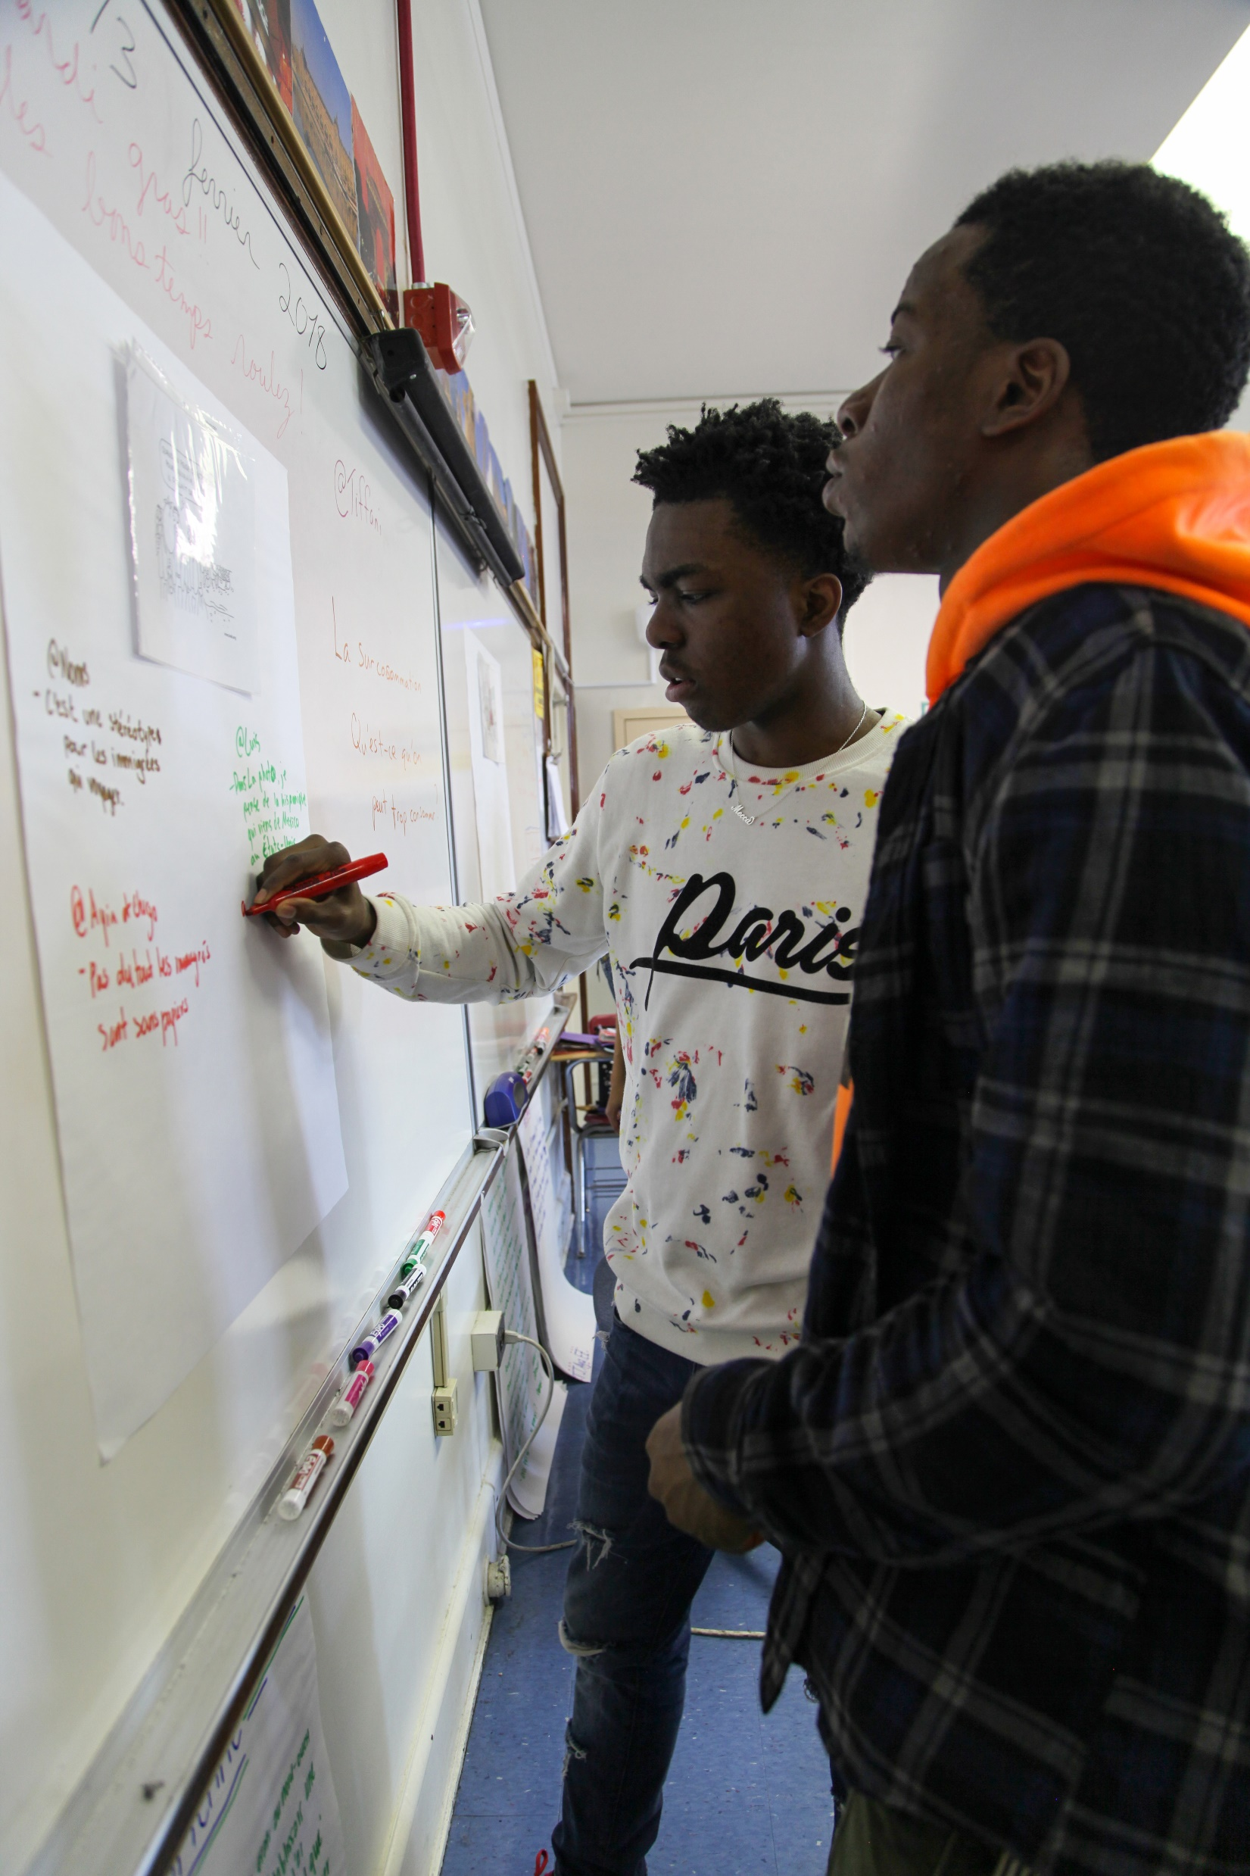
Page 4: College
Likelihood of admission based on application data (Likely, Match, Reach) (9th-11th grade Guide)
Colleges listed are based on individual student factors and Smart College Choices
Smart College Choices are informed by graduation rates and history of DCPS student success at the colleges.
Visit the links provided to read more about financial aid and scholarships.
Notes:
The next page is the college page. This page contains personalized information about area colleges and admission likelihood based on student’s current performance against DCPS historical performance
Click:
All DC Colleges are listed for each student. Additional colleges are based on individual student factors (GPA and SAT) and Smart College Choices- informed by graduation rates and history of DCPS student success.
The number of caps for each school represents likelihood of admission (Likelihood of admission is a component of the 9-11th grade guide, 12th grade guides will only list Smart College Options and not list Likelihood)
3 caps = Likely
2 caps = Match
1 cap= reach
You can read more about SMART college choices on the right side of the page.
We have lots of additional resources, including information about financial aid and scholarships. Visit the links provided to read more.

Slide 11
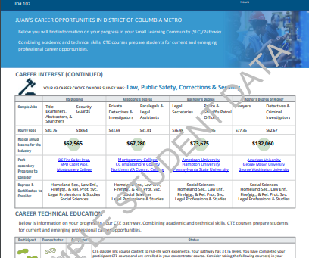
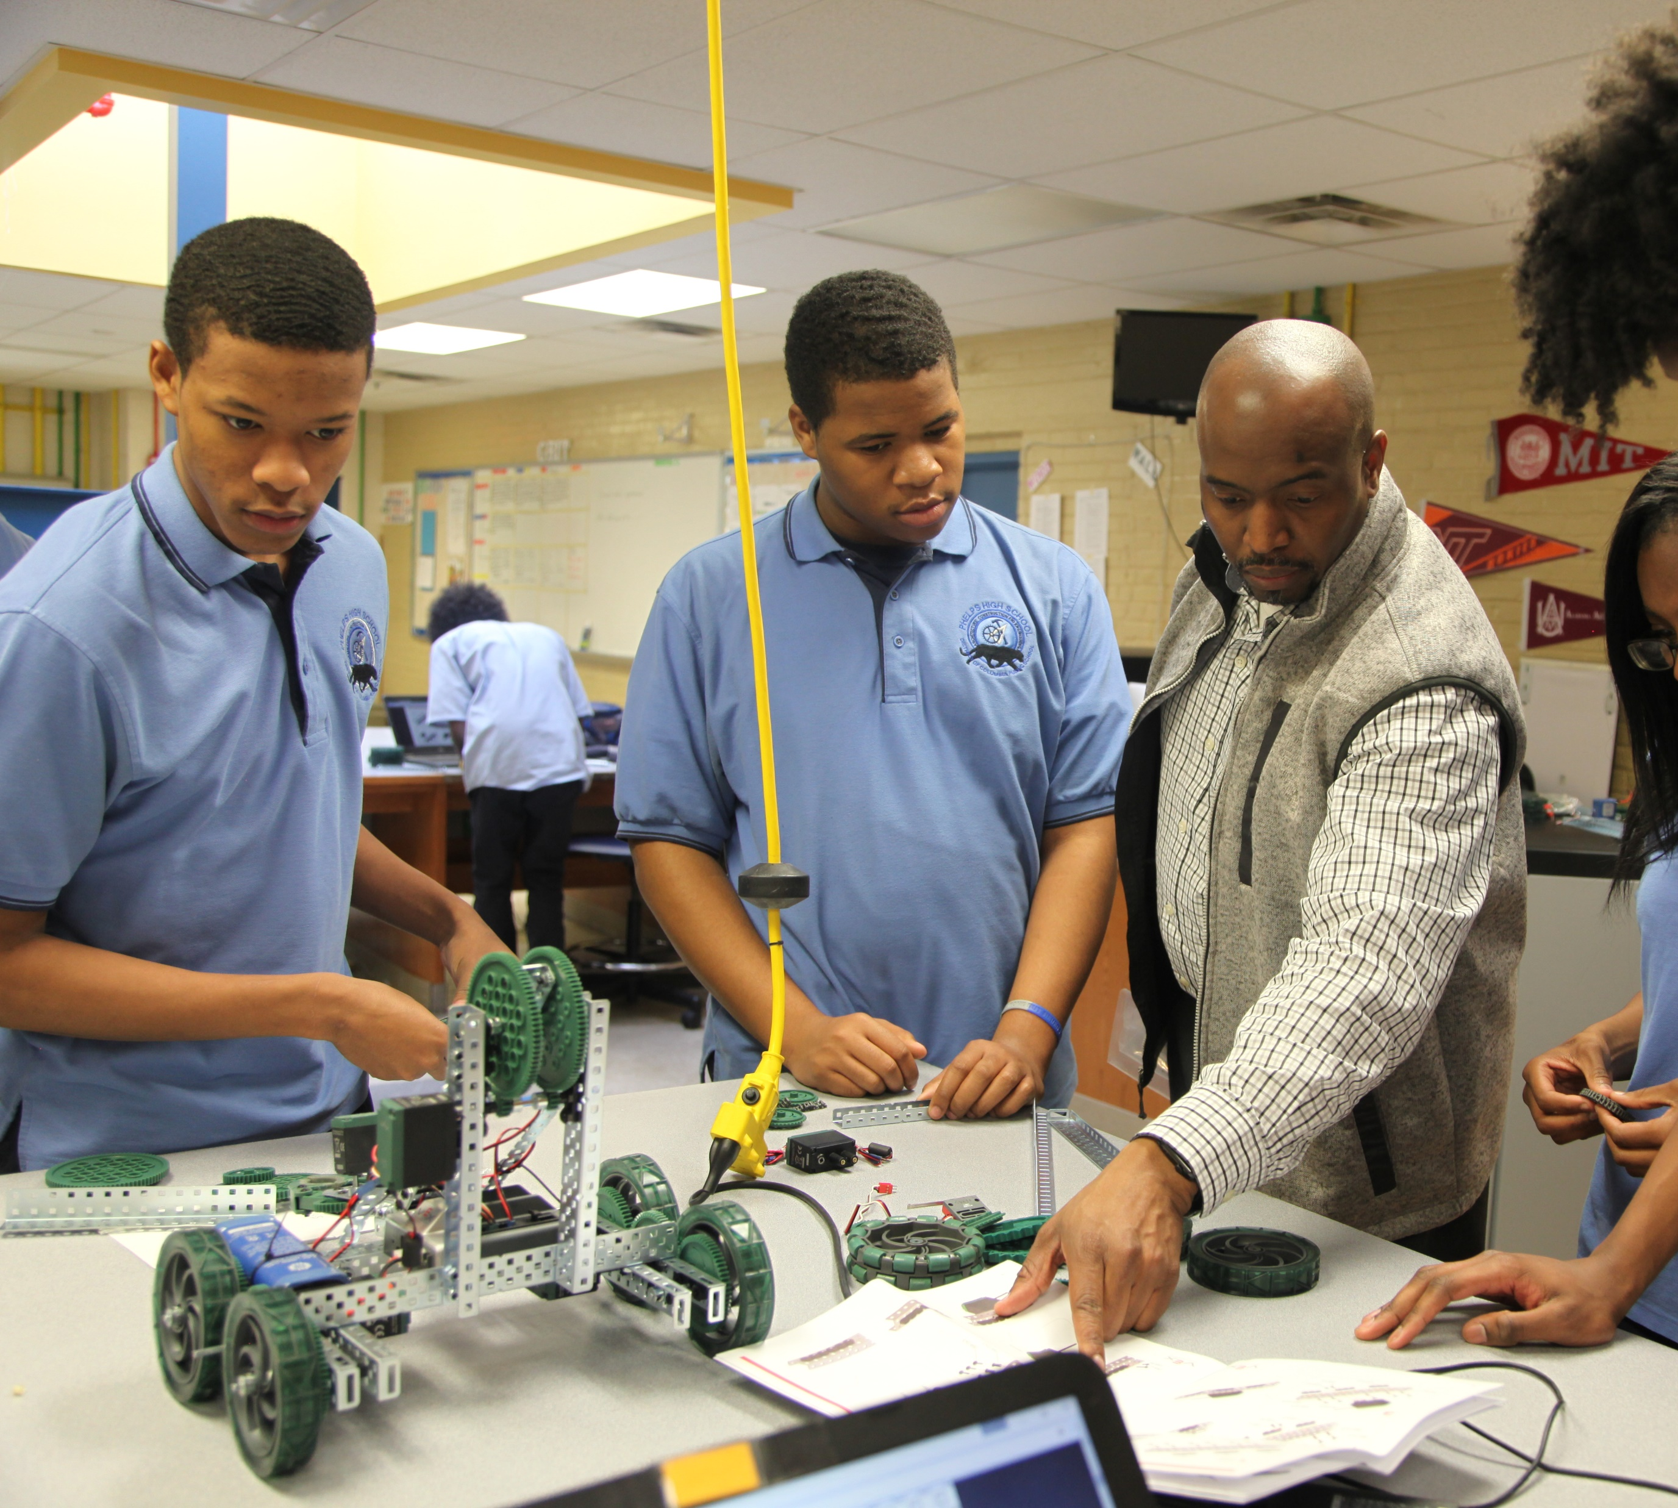
Page 5-6: Career, CTE, and Work-based Learning
Includes Career Cluster information based on student’s selected interests in Naviance
Salary
Programs and schools to consider
Broken down by education attainment
If no postsecondary survey was completed, career information for 3 high wage/high demand fields are populated:
Business Administration
Information Technology
Health Sciences
CTE progress and Work-Based Learning programming will appear if student has participated in those areas
Notes:
The next page is the Career Page. This page helps you consider what different career paths you are interested in pursuing.
Click
Overview of Career Page. The data populated here is based on the survey students completed in Naviance. If you didn’t complete the survey, the top three high wage/high demand career clusters for the DC Region will populate. You’ll see different career paths within each cluster and the earnings potential for different levels of education achieved. The colleges and universities listed are selected based on the programs that they offer in the field.
Salary data comes from the Bureau of Labor and Statistics from the DC area.
Students in Career and Technical Education (CTE) Programs will see CTE Progress and Work- Based Learning at the bottom of the page..

Slide 12
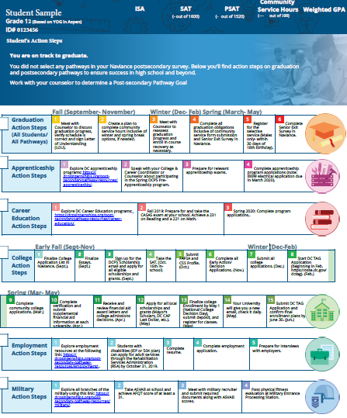
Page 7: Action Steps
Each student will receive specific action steps towards HS graduation as well as specific information for all 6 postsecondary pathways
Each pathway will also include action steps that can be taken in the fall and spring prior to graduation as well as links to resources.
If a student selected a postsecondary pathway in their Naviance survey, those pathways will be highlighted on top page
Notes:
The final page includes key action steps for each of the 6 postsecondary pathways. This is to help make sure that if you did change your postsecondary pathway goal, you’ll still have access to key action steps in all pathways.
If a student did select a postsecondary pathway in Naviance, it will be highlighted at the top of the page.

Slide 13
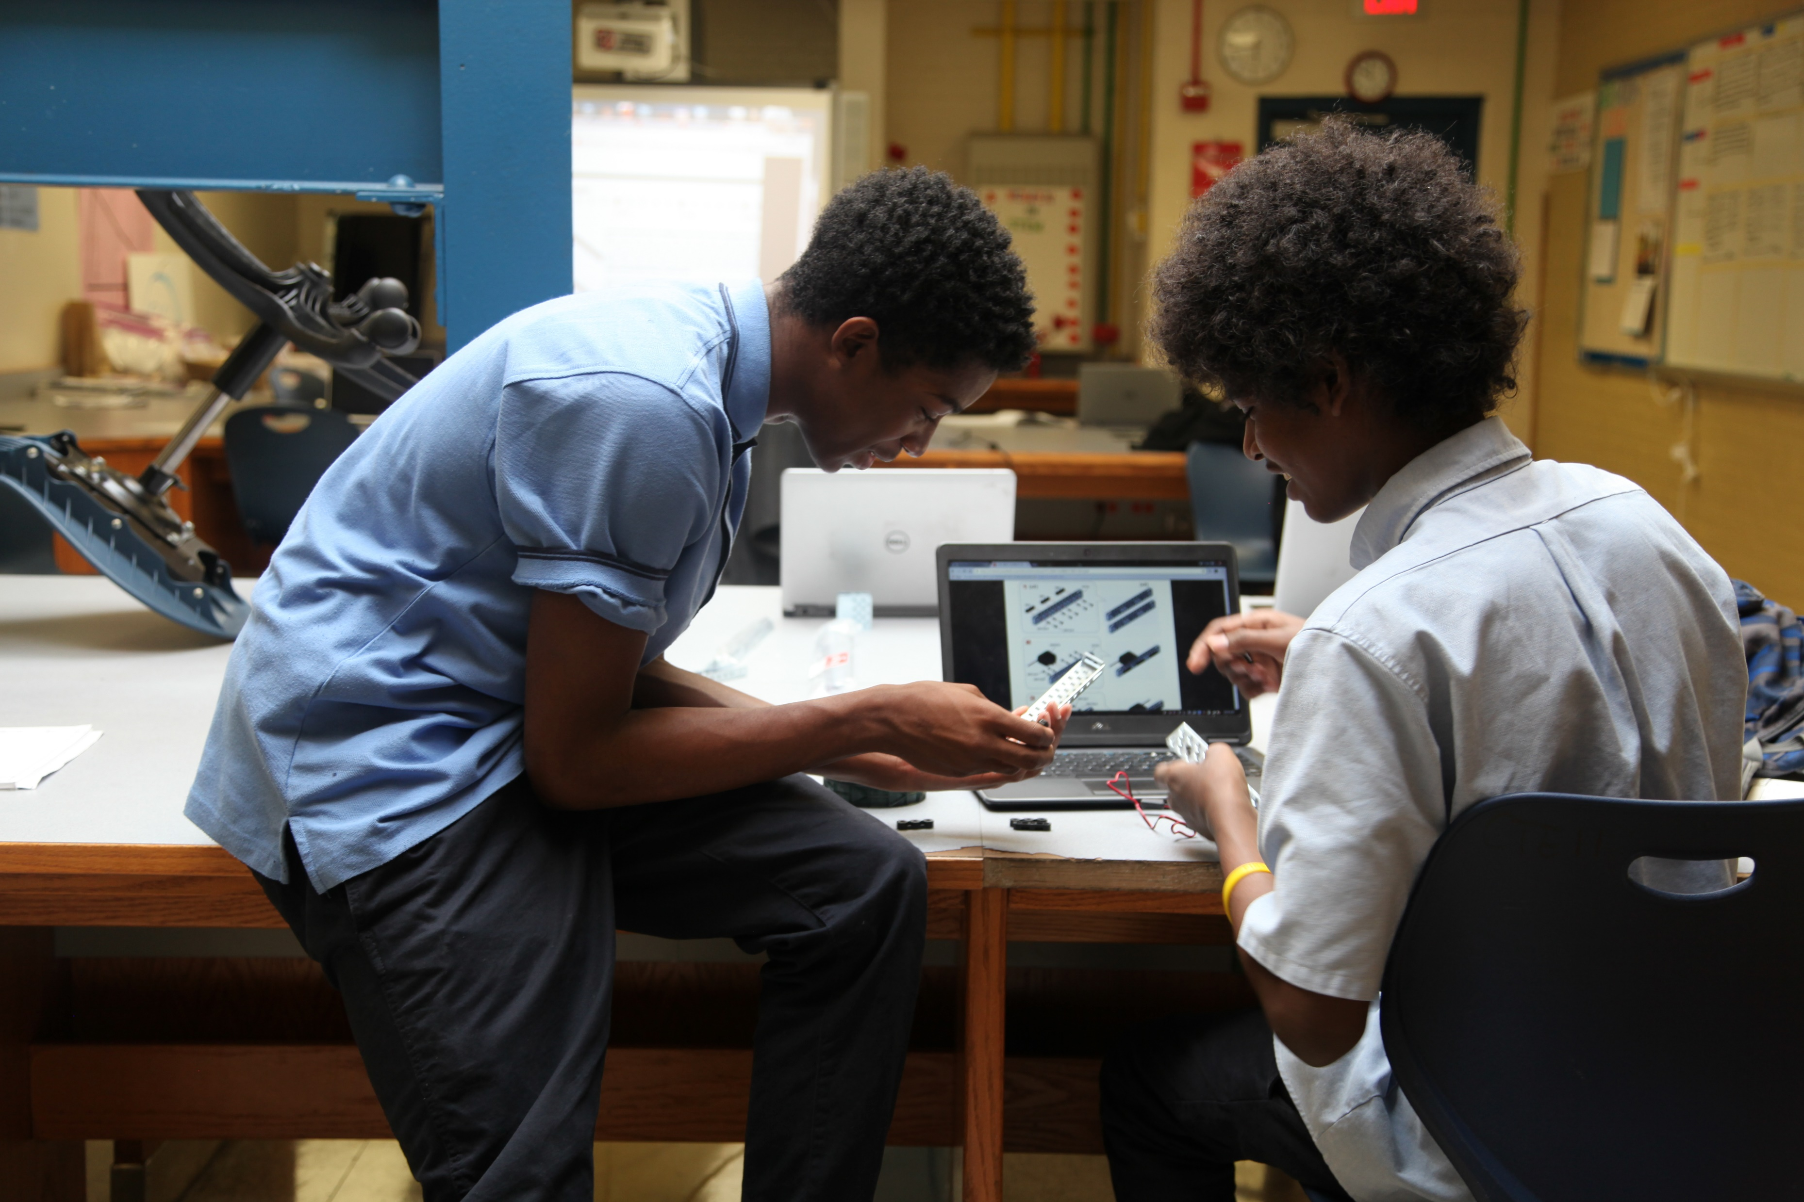
Discussion
Notes:
Now that we’ve reviewed the content of the guide, let’s take some time to think and share what’s most interesting and how we’ll use it.

Slide 14
Think. Write. Pair. Share
What information in the Guide is most interesting or important for you? What will you do with that information?
What is one action step that you will prioritize? Who do you need to help you with this step?
Notes:
Look at your own Guide to Grad, College and Career.
Reflect on and write down 1-2 pieces of information in your guide that you found most interesting or important. (5 min)
Now turn to your neighbor and share.
Finally, decided on the one Action Step that you want to prioritize and give yourself a due date. Also think about who you made need help from to accomplish this action and write it down. (5 min)
Share that with the person to your other side

Slide 15
Keep in touch!
[Counselor Name and Contact Information]
[Other school POC Name and Contact Information]
More helpful links and resources can be found at:
Https://dcpsgoestocollege.org/guide-resources/
Notes:
If you have questions or need help with the action items on your guide, reach out to your counselor and {insert school specific POC here}

